Slide 1

Web Site Stewardship
Reorganizing Site
Cleaning up Coding
Reducing files & image sizes
Prevent bad coding
Link Checker

Slide 2
Reorganizing Site
Placing loose files in folders
  Will help eliminate multiple copies of the same file.
    For example – Decatur County – because of not using folders there have been duplicates, triplicates, maybe more. Which, when adding huge graphics, it ate up even MORE server space!
Deleting duplicates
  Files/Pages
  Images

Slide 3
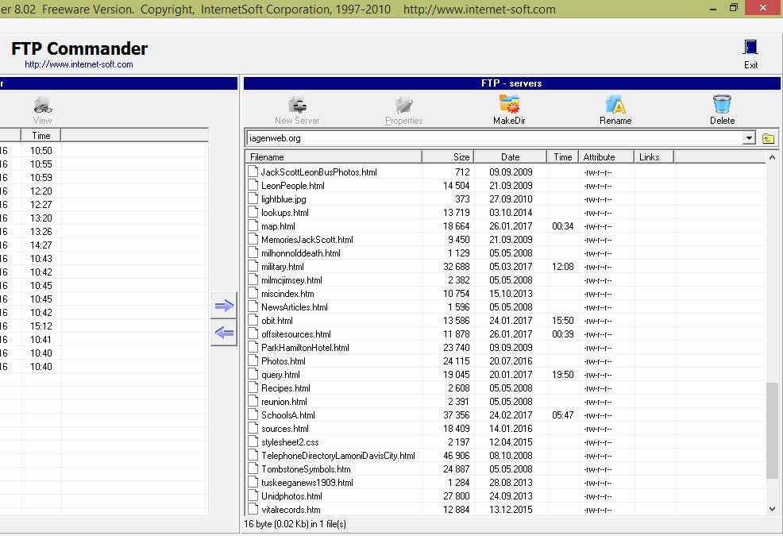
Loose files not in folders

Slide 4
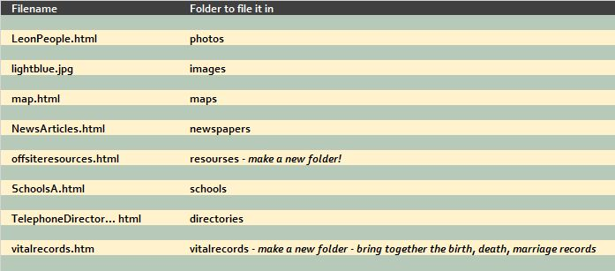
Loose Files placed into Folders

Slide 5
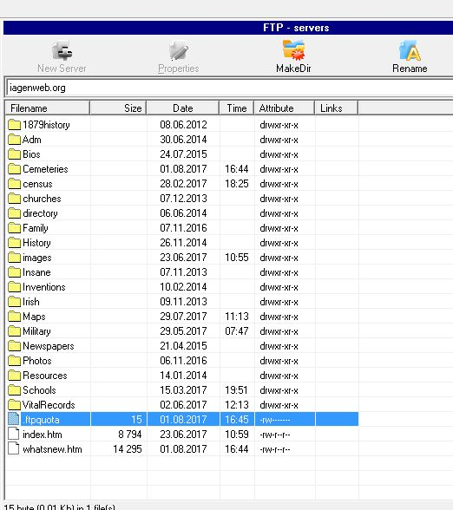
How the server side of FTP will look without loose files. The index (home page) and the What’s New are not in folders.

Slide 6

Deleting Duplicates
Files/Pages
  Same file/page used in more than one location?
  Has it been stored in more than one folder?
  Choose one folder for the page and link all locations to the same page.
  For example: St. Mary’s Catholic Cemetery History
  http://iagenweb.org/dallas/cemetery/StMarysHistory.htm
  Stored in the cemetery folder
  Linked from:
  1. Dallas County Cemeteries index
  2. History index
  3. St Mary’s Catholic Cemetery page

Slide 7
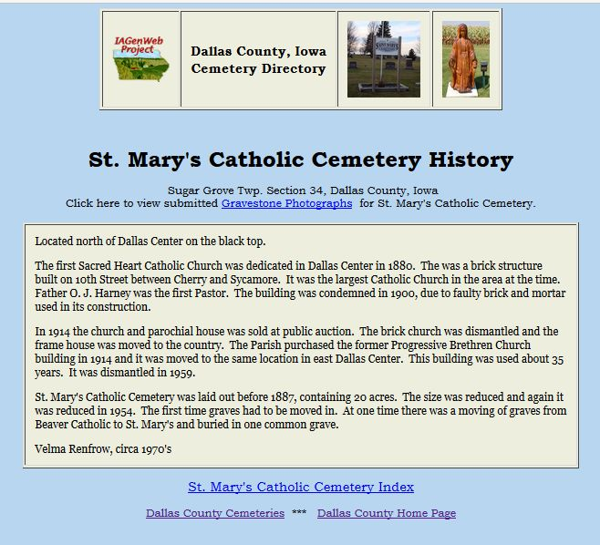
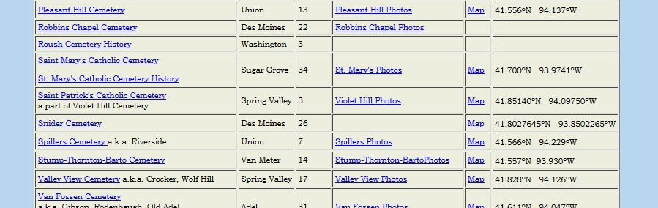
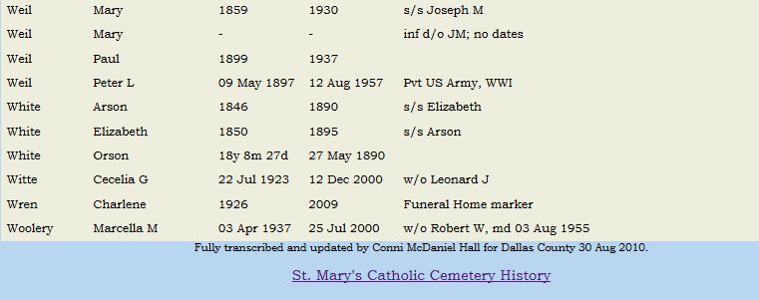
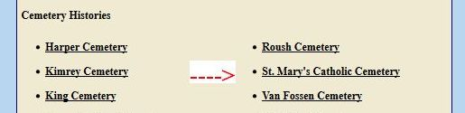
St Mary’s Catholic Cemetery History
Cemetery Index
St Mary’s Catholic Cemetery Index
History Index

Slide 8
Deleting Duplicates
Images
Do you have the IAGenWeb logo in more than one folder?
How about the same background image?
Maps?
Photographs?
For example – Blank School building photo – so easy to put in the Schools folder AND the Photos folder AND the images folder. As it is displayed on the Blank School page AND the Blank County Photos page. Choose one folder and link all locations back to the image in that folder.

Slide 9
Cleaning up Coding
Using the Replace feature in web editors and Notepad
Online tools – http://www.seabreezecomputers.com/htmlstripper/
Deleting unnecessary folders

Slide 10
Before
After
<tr height="51" style="height:38.25pt">
<td height="41" class="xl24" width="134" x:str="Adel "><font face="Bookman Old Style" color="#800000">Adel<span style="mso-spacerun:yes">&nbsp;</span></font></td>
<td class="xl24" width="256" x:str="Dallas County Record " height="41"><font face="Bookman Old Style" color="#800000">Dallas County Record<span style="mso-spacerun:yes">&nbsp;</span></font></td>
<td class="xl24" width="86" x:str="Weekly " height="41"><font face="Bookman Old Style" color="#800000">Weekly<span style="mso-spacerun:yes">&nbsp;</span></font></td>
<td class="xl24" width="178" x:str="Thursday " height="41"><font face="Bookman Old Style" color="#800000">Thursday<span style="mso-spacerun:yes">&nbsp;</span></font></td>
<td class="xl24" width="97" x:str="Rep " height="41"><font face="Bookman Old Style" color="#800000">Rep<span style="mso-spacerun:yes">&nbsp;</span></font></td>
<td class="xl24" width="173" x:str="Record Pub. Co. " height="41"><font face="Bookman Old Style" color="#800000">Record
Pub. Co.<span style="mso-spacerun:yes">&nbsp;</span></font></td> </tr>
<tr><td>Adel</td><td>Dallas County Record</td>
<td>Weekly</td><td>Thursday</td><td>Rep</td>
<td>Record Pub. Co.</td></tr>

Slide 11
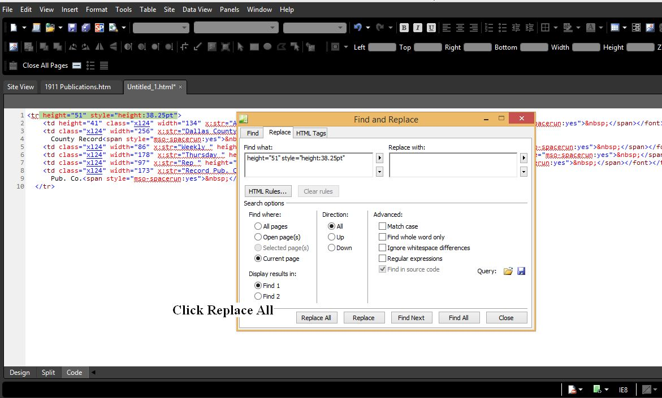
Web Editor

Slide 12
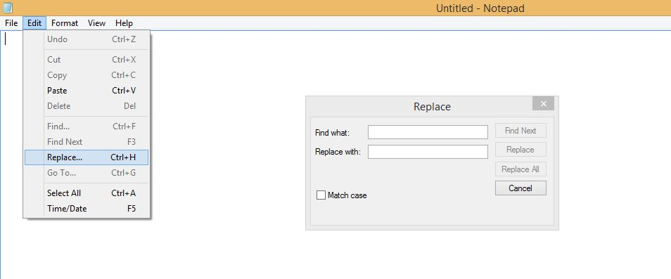
Notepad

Slide 13
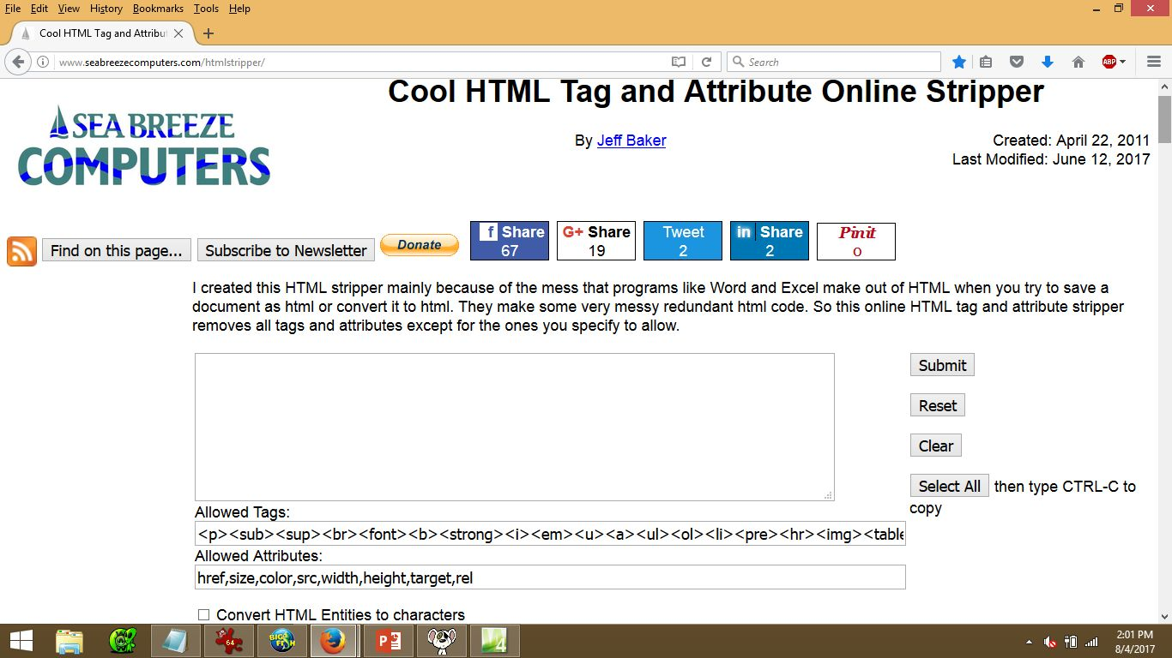

Slide 14

Delete the highlighted items

Slide 15
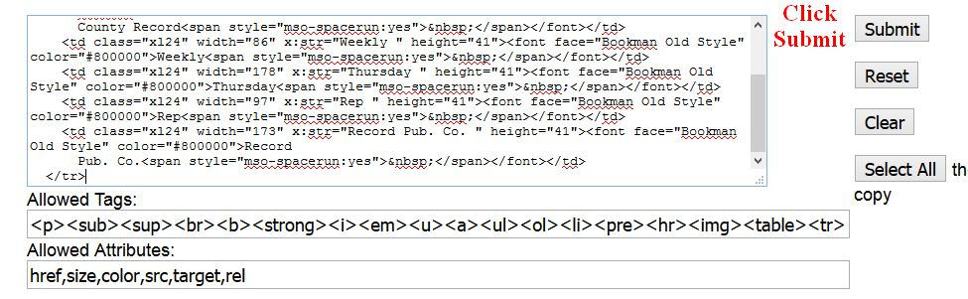
Before clicking Submit

Slide 16
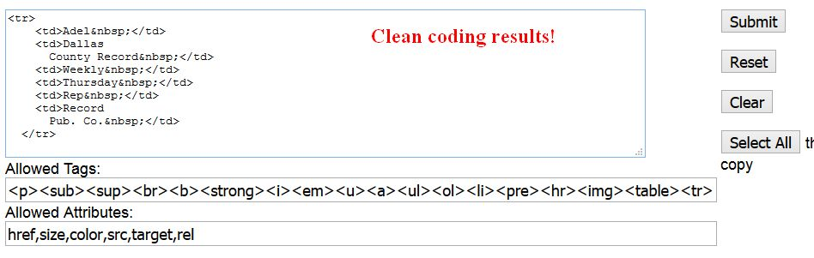
After clicking Submit

Slide 17
Deleting Unnecessary Folders
_notes
_vit_cnf
thumbs.db

Slide 18
Reducing files and image sizes
Files should not be more than 350 KB in size
  First, clean up coding.
  Second, may need to divide into more than one page
Images should not be more than 200 KB in size
  Resolution 72 pixels
  Height/Width not over 1000 pixels
Converting GIF to JPG.
  Irfanview will allow saving a .gif image as a .jpg image.
  .jpg’s are easier to reduce the size of the image.

Slide 19
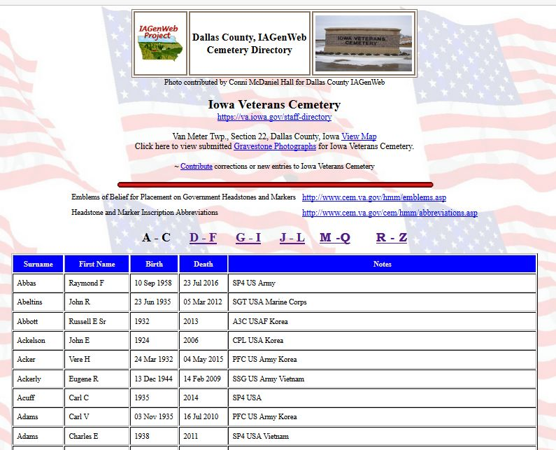
The 6 pages combined is 663 KB

Slide 20
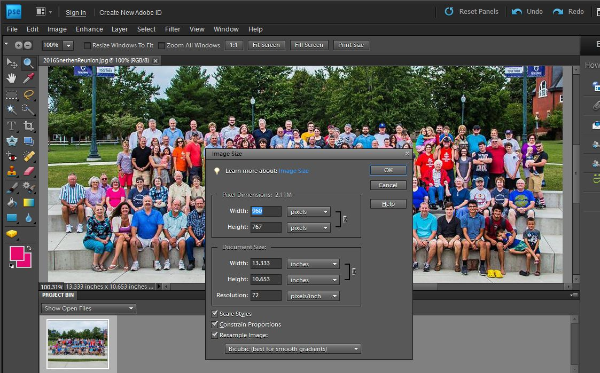
Resolution: 72 pixels; Width: 960 pixels; Height: 767 pixels

Slide 21
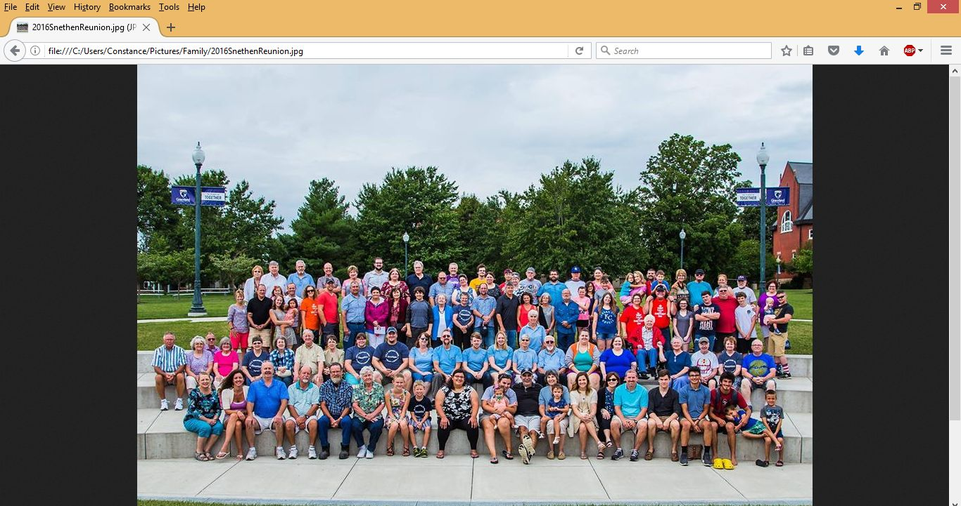
Open the photograph in your browser to see how it will look in its new size.
157 KB from 573 KB

Slide 22
Various Photo Editors
Adobe Photo Shop – $ - $$$$$
Irfanview – FREE!
  http://www.irfanview.com/
Expression Web has Paint – Free
  https://www.microsoft.com/en-us/download/details.aspx?id=36179

Slide 23
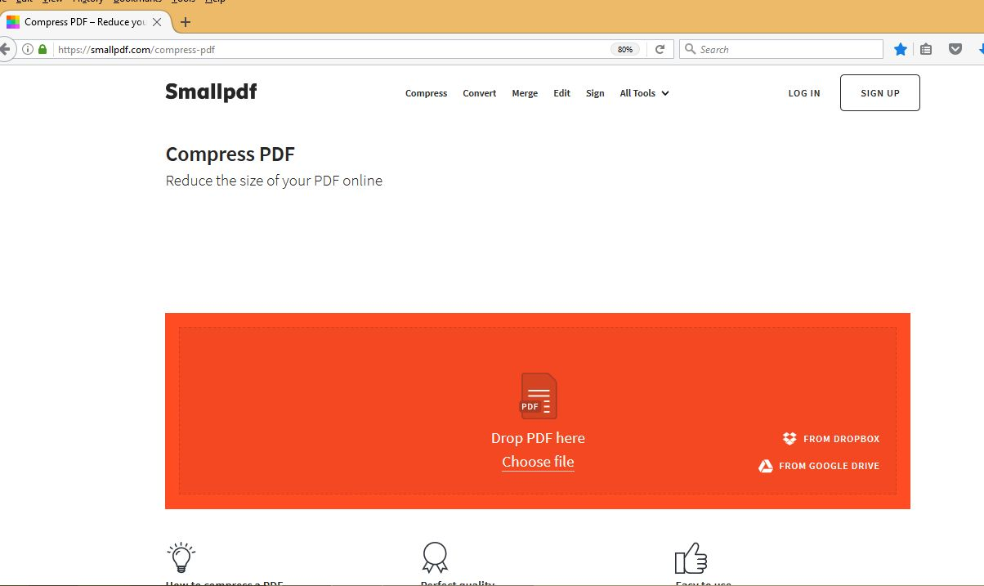
Reducing the size of PDFs – this program is not always going to get the pdf down to the size that’s preferable. You may need to do a pdf-to-text to reduce the size sufficiently. https://smallpdf.com/compress-pdf

Slide 24
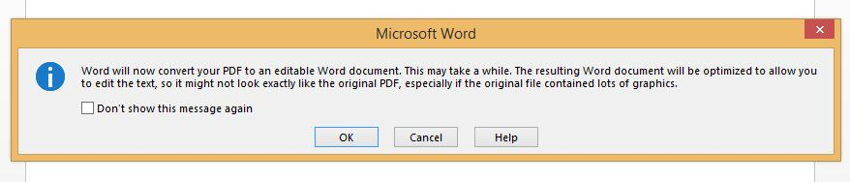
Open PDF in MS Word
Click OK

Slide 25
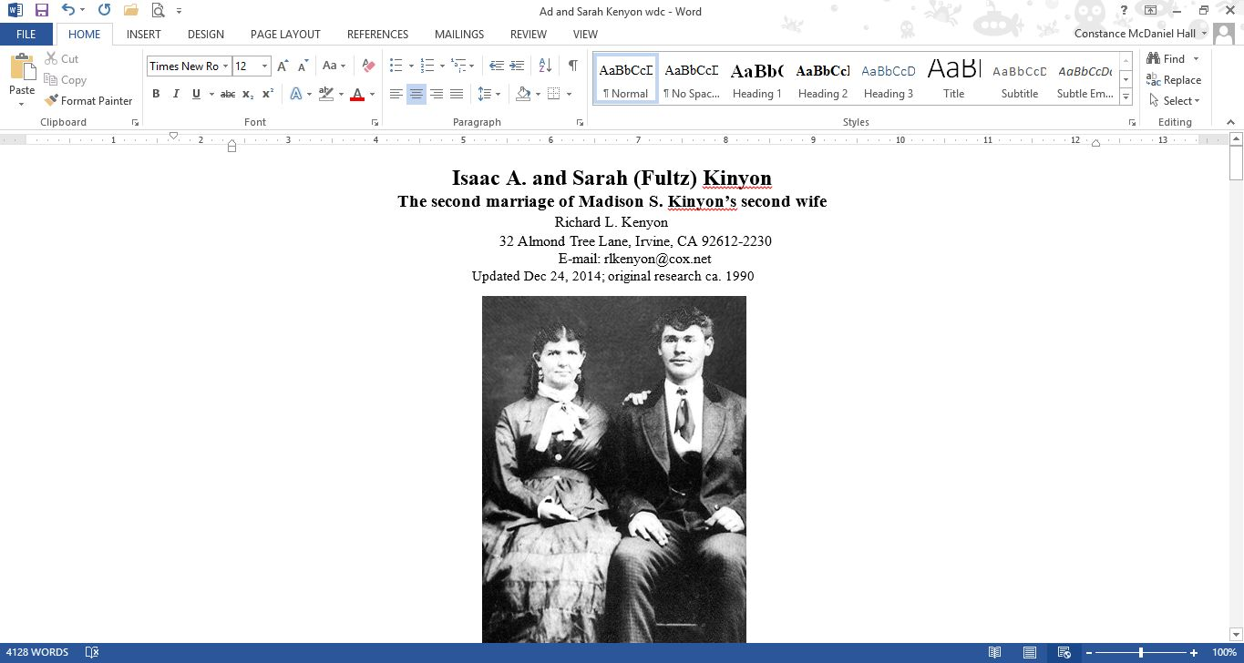
PDF opened in Word

Slide 26
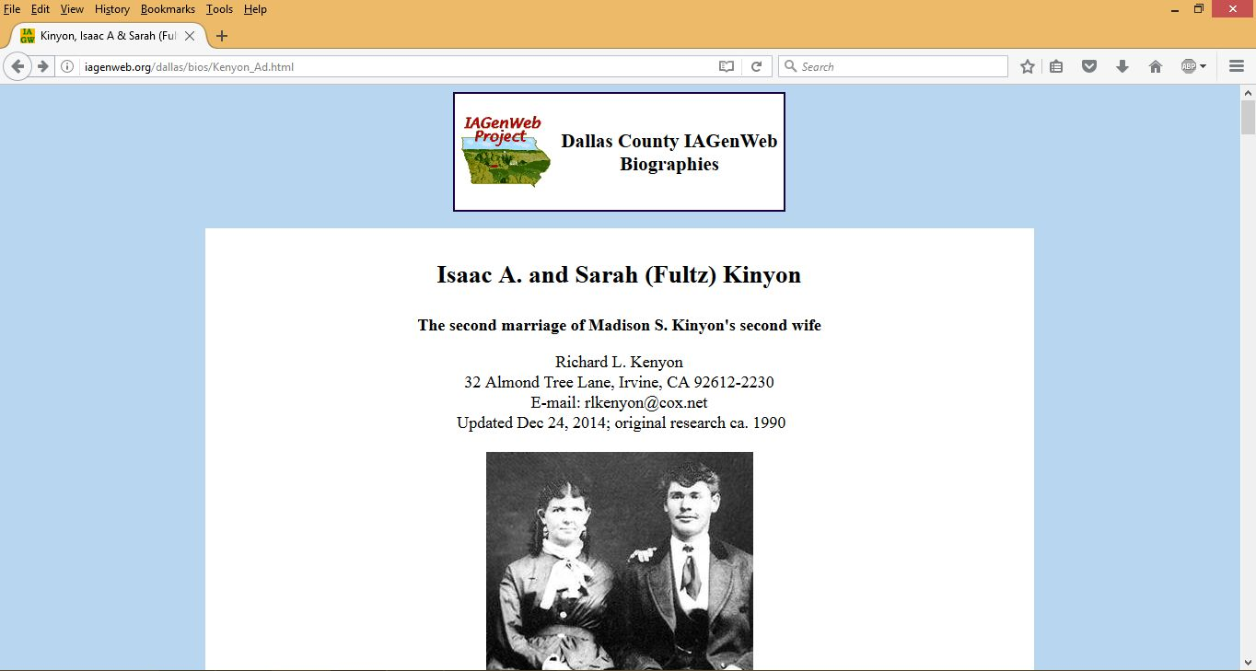
I saved the photos to a folder. Copied and pasted the text into my web editor. Removed any images - photos & lines that were inserted between columns. Cleaned the coding using Seabreeze online HTML stripper. Utilizing the original still open in Word, replaced photos and corrected formatting. Result – original 683.76 Kb reduced to 31.32 Kb + 172.14 (images) = saving 480.3 Kb of space.

Slide 27
Prevent Bad Coding
Copying directly from MS Word and/or MS Excel into the web page will dump garbage into the coding. To help prevent that from happening, try these tips.
  Transcribe into the web editor or Notepad instead of MS Word.
  Use Notepad to strip formatting from MS Word
  Using online tools – these are the ones I use – you may know of others you prefer
    Convert Word Doc to HTML http://www.textfixer.com/html/convert-word-to-html.php
    Spreadsheet to HTML – Tableizer http://tableizer.journalistopia.com/

Slide 28
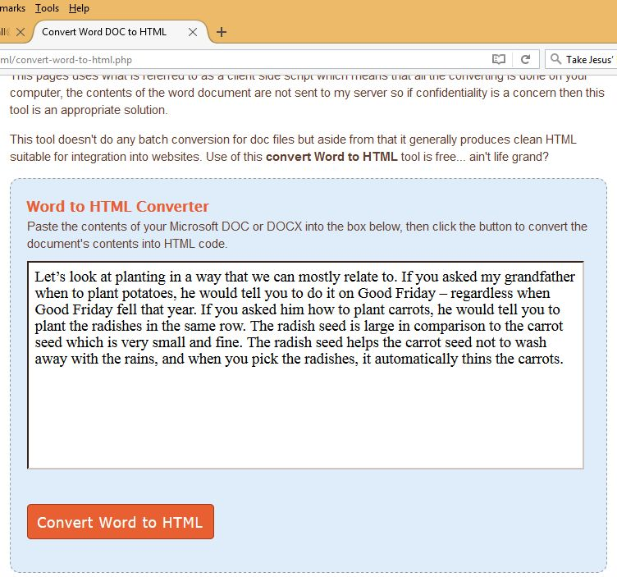
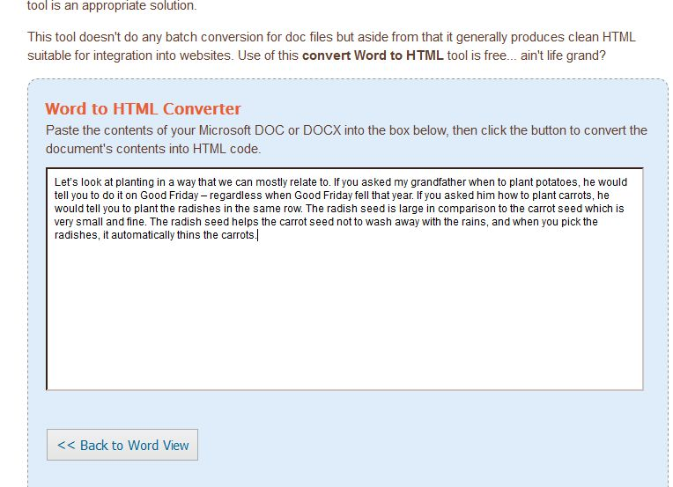
Word Doc to HTML

Slide 29
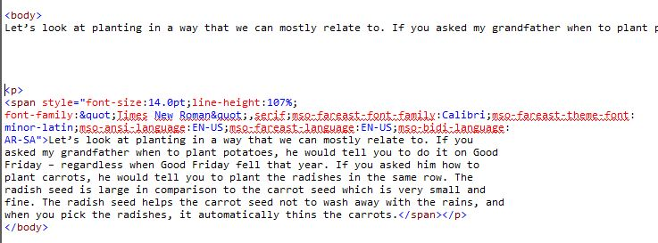
Top – clean coding – nothing but the paragraph
Bottom – notice the Space eaters!

Slide 30
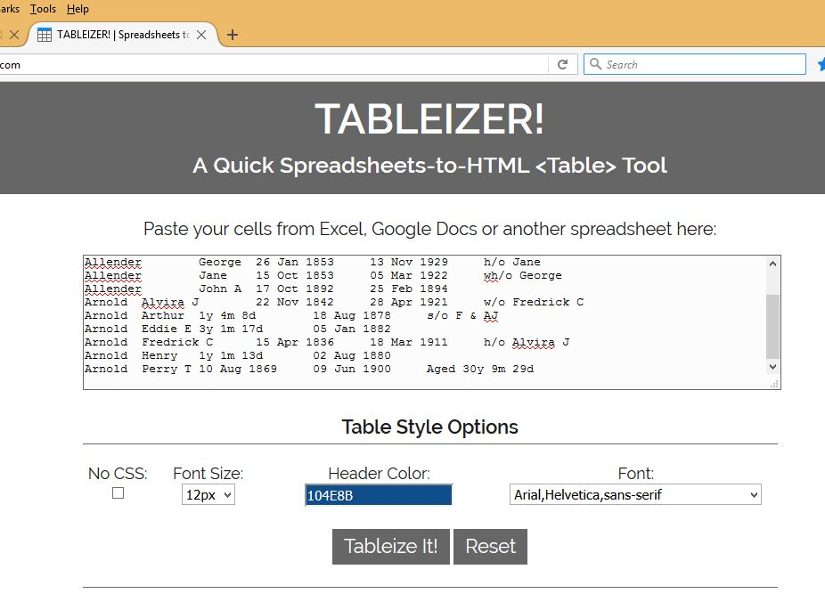
Tableizer – copy from Excel

Slide 31
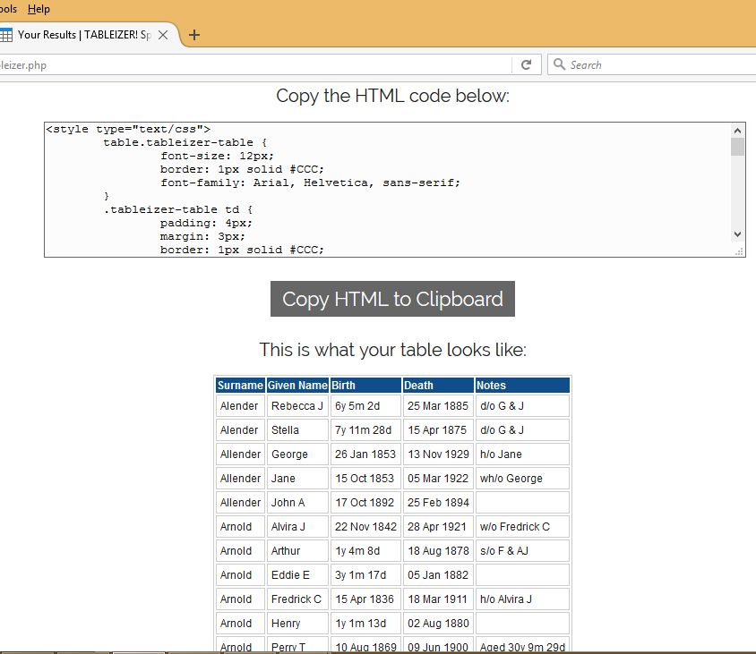
Tableizer – finished example and HTML code

Slide 32
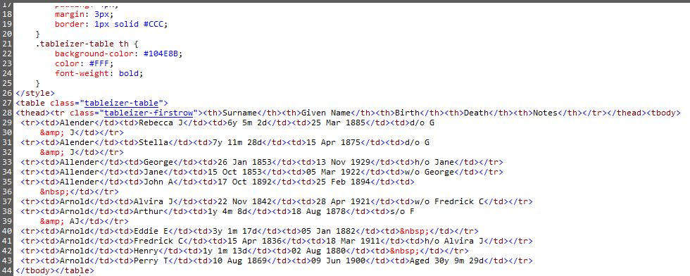
Code from Tableizer

Slide 33
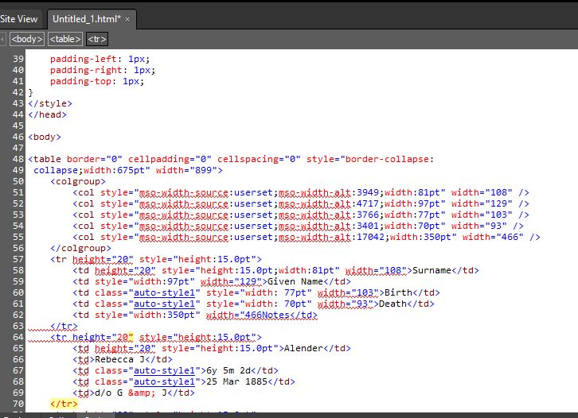
Code from copying directly from Excel

Slide 34
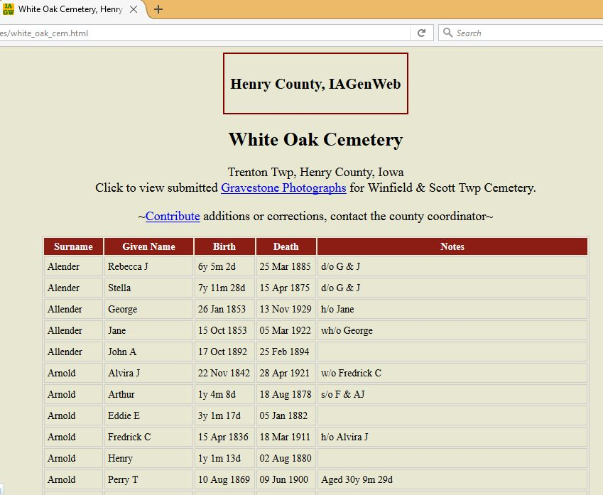
Finished product

Slide 35

Link Checker - Xenu
Finished with the cleaning up you’re going to do? Now it’s time to make sure everything works. Run Xenu or your favorite link checker. Repair all broken links and missing images – photos and graphics. It’s always good to go page by page to make sure you don’t have any misspellings, typos, etc.
Note: If you have Redirects – check to see if they are permanently changed. If so, they need cleaned up or they will eventually be broken links.
Now invite the membership over to admire all of your hard work!

