Slide 1
Tips on good web site Design

Slide 2
Our Purpose: The IAGenWeb Project is dedicated to gathering and presenting Iowa genealogical and historical information for free, online access by researchers. We are a division of USGenWeb.
Our visitors open a county page in hopes to learn more about their ancestors.
Design can determine
How long a visitor will stay at your page.
Their comfort or frustration level as they navigate the site.
Their experience will determine if they will return.
And if they will become a contributor.

Slide 3
Home page basic needs
Follow the Rules and Bylaws.
IAGenWeb and USGenWeb linked logos; located so that the viewer does not need to scroll to see them
Trademark – XX County IAGenWeb or IAGENWEB
CC name and contact information in an easily visible location
Search engine – you should not have to “search” for the search engine.
Friends of IAGenWeb link (linked logo preferred)
Copyright information as the bottom of the page
Directory – think of as a table of contents
To be viewed with as few of scrolls as possible from the top to the bottom of the page

Slide 4
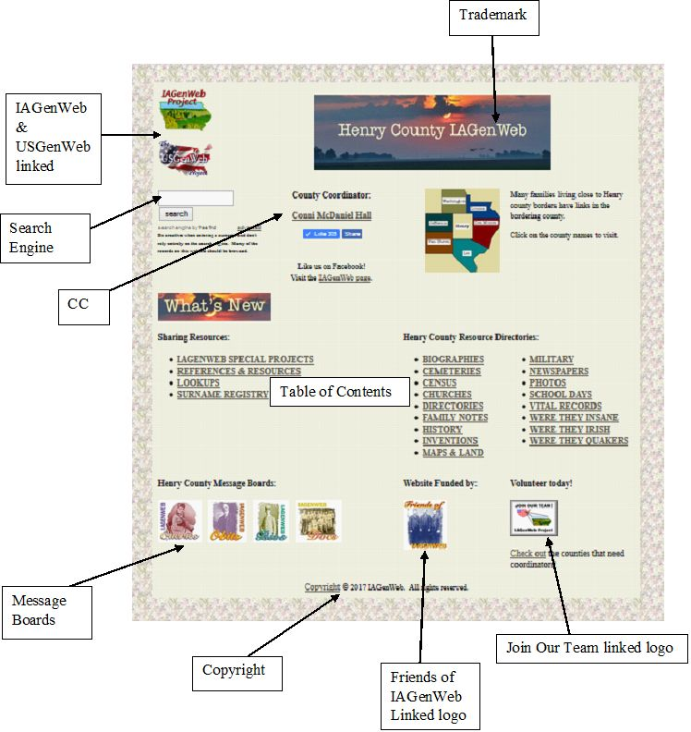
Here is an example of well-designed Home Page
It is recommended that the CC name and contact information be presented near top of the Home page and place the Search Engine in a very visible location.

Slide 5
Trademark
The following are unacceptable:
Required format:
Iowa GenWeb
IowaGenWeb
IAGenweb
IA GenWeb
Iagenweb
IAGenWeb or IAGENWEB
To find trademark problems use your site’s search engine to find them.
I was startled to learn that my Muscatine site had all kinds of trademark issues found in pages created several years ago. After all this site was established in 1996 and has had a several coordinators.

Slide 6
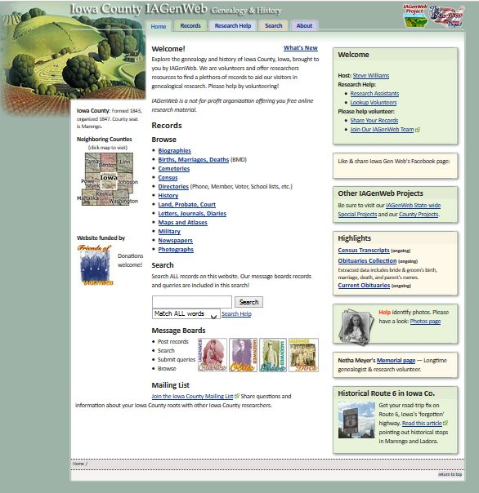
Users tend to read Web pages in a F-shaped pattern:
They first read in a horizontal movement, usually across the upper part of the content area.
Then drop down a bit and read across in another horizontal movement.
Then they scan the content’s left side in a vertical movement.
How many scrolls does it take for someone to view your Home page? Your goal is to make it easy to read and quickly lead visitors to various topics.

Slide 7
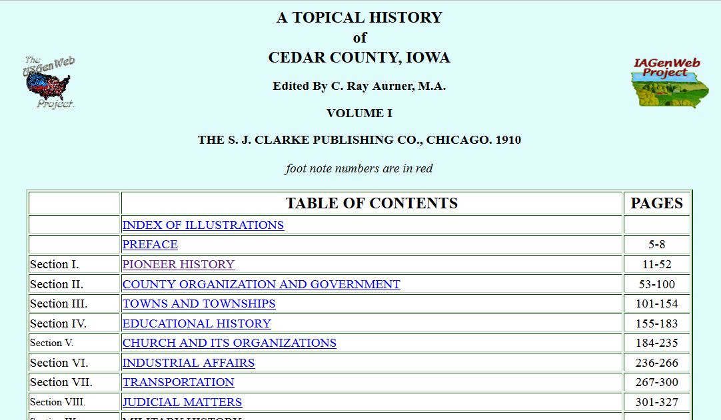
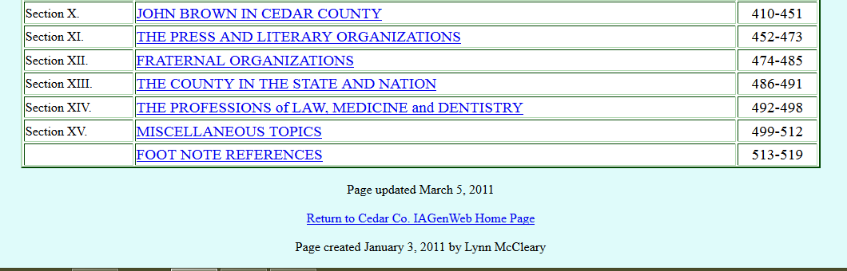
Think of your Home page as the Table of Contents as found in a book. Consider placing a link to a topic index and to the Home page.
Expecting the visitor to know to use the back button is something to think about. I can’t tell you how frustrated I feel when I get knocked off the site because there is no return to home link or that I have to hunt down where I just was within a site.

Slide 8
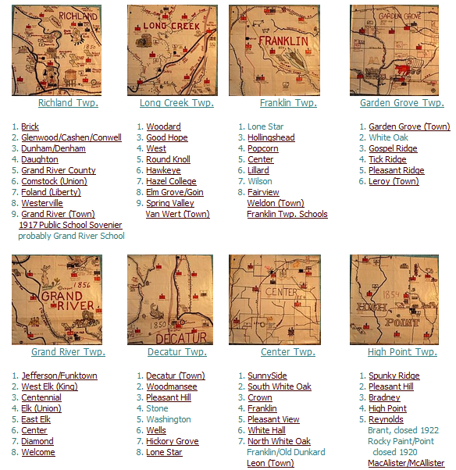
Consider Our Visitors – who are they?
A large number of our visitors are “seniors” ages 55+
Eyesight, precision of movement and memory are often affected by the human aging process.
To have best readability use at least 10-12 point type as the default for text.
Give some space around link or icons – for users who are not steady with the mouse.

Slide 9
Use contrast so that your text stands out against the background.
If you would like to play around with color charts then Google web page color charts and you will get all kind of material.
Black on light yellow is one of the most contrasting.
Text on dark backgrounds tend to be more difficult to read.
Patterned backgrounds often make it difficult to read the text.
Identifying click-ability on links.
Standard link colors are blue which changes to purple after it is used.
Remember that we have visitors who are color blind and can’t distinguish between green and red.
Red is not a standard color and the link does not change color after it is used.
On some pages I have had a hard time picking out the clickable link because the font color is too light.
See the next slide for color do’s and don’t’s.

Slide 10
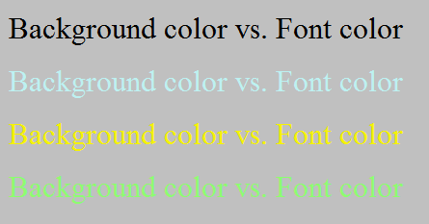
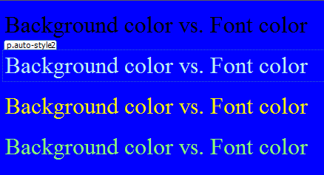
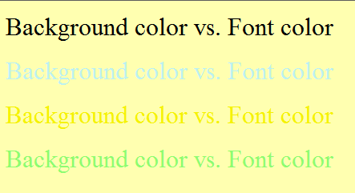
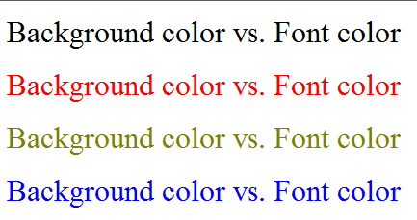
Design Principles - Colors

Slide 11
Basic needs for individual pages
Identify the page as an IAGenWeb project
Provide good navigation – back to the directory and, preferably, to the Home page.
Credit the contributor
Documenting Resources
Date when added and/or updated

Slide 12
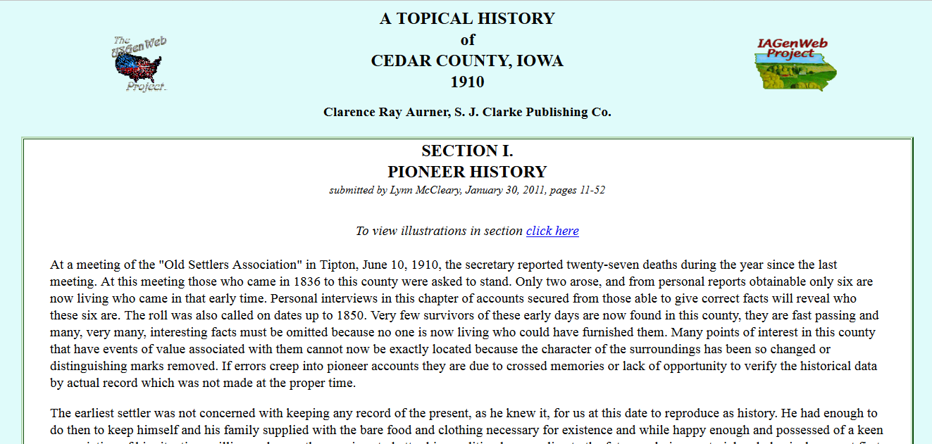
Elements on a page should be placed so that the page appears visually balanced. Consider including white space between the edge of your computer screen or table and the text. See above image.

Slide 13
Establish consistent patterns in your page layout.
Create a template by utilizing Cascading Style Sheets or a basic page layout doing copy and save-as.
The navigation links should appear in the same place on each page, and have the same design.
Headers and footers should also be the same from page to page.

Slide 14
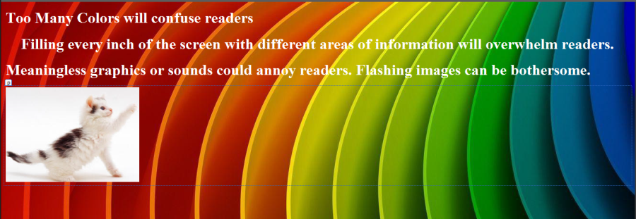


Slide 15
Should you decide to redesign your site -
Develop a layout plan
Study your site – get a good understanding how your page are linked.
Take it in baby steps.
When you have made changes – be sure to run a link checker and have Freefind re-index the site.

